Slide 1
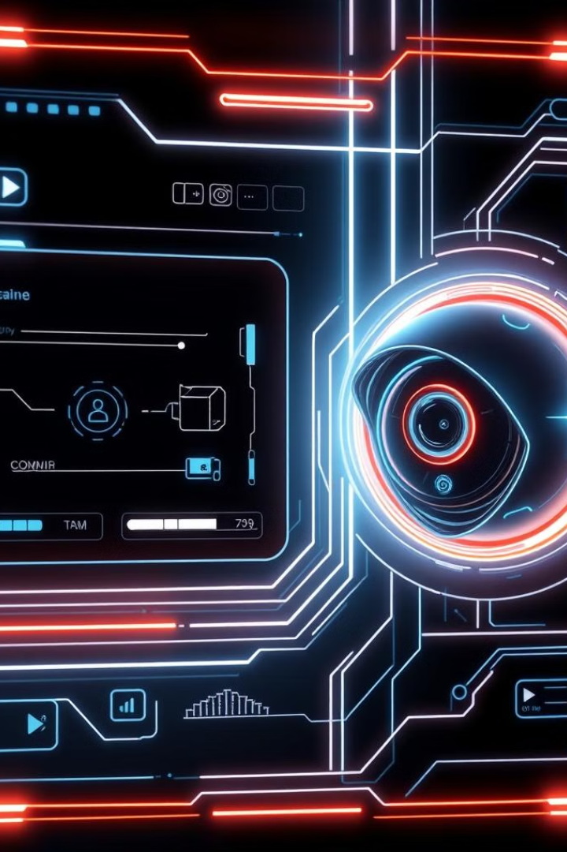
Intelligent Intruder Detection System
This presentation introduces an advanced intruder detection system. It leverages a Raspberry Pi 4 for real-time monitoring and threat identification. The system employs cutting-edge computer vision and machine learning techniques to protect your property.
by Aaron Anil, Navaneet Krishnan, Vaishnav S Nair

Slide 2

The Motivation for Intelligent Security
Rising Burglaries
High False Alarms
Over 2.5 million home burglaries occur annually in the US.
Traditional systems have a 70% false alarm rate.
Significant Losses
The average property loss per burglary is $2,661.
The need for cost-effective, intelligent solutions is clear. Emerging AI and IoT technologies offer smarter security approaches.

Slide 3
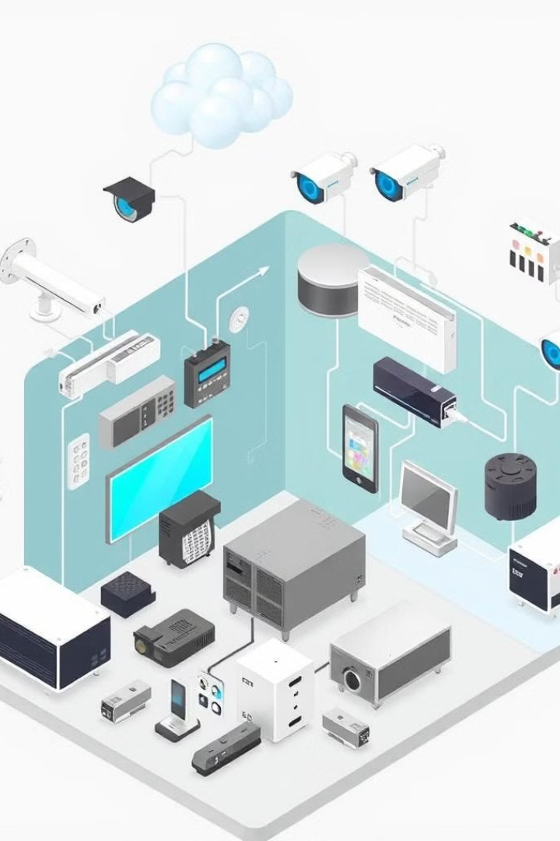
Literature Review: Existing Approaches
System
Methodology
Key Advantages
Limitations
OpenCV Motion Detection
Frame Difference
Low Cost
High False Positives
PIR Sensor Systems
Infrared Sensing
Simple Implementation
Limited Detection Range
Commercial AI Cameras
Deep Learning
High Accuracy
Expensive
Raspberry Pi Security
Computer Vision
Flexible
Computational Limitations
Machine Learning Models
Neural Networks
Adaptive Learning
Complex Setup
Cloud-Connected Systems
Remote Monitoring
Scalable
Dependency on Internet

Slide 4

Problem Statement: Gaps in Current Security
Lack of Intelligence
Cost Barriers
Existing systems struggle with intelligent threat discrimination.
Low-cost implementation options are limited.
Inflexible Systems
Current systems lack flexible customization for unique needs.
Our goal is an affordable, intelligent intruder detection system. Specific challenges include minimizing false alarms and enabling quick threat response.

Slide 5
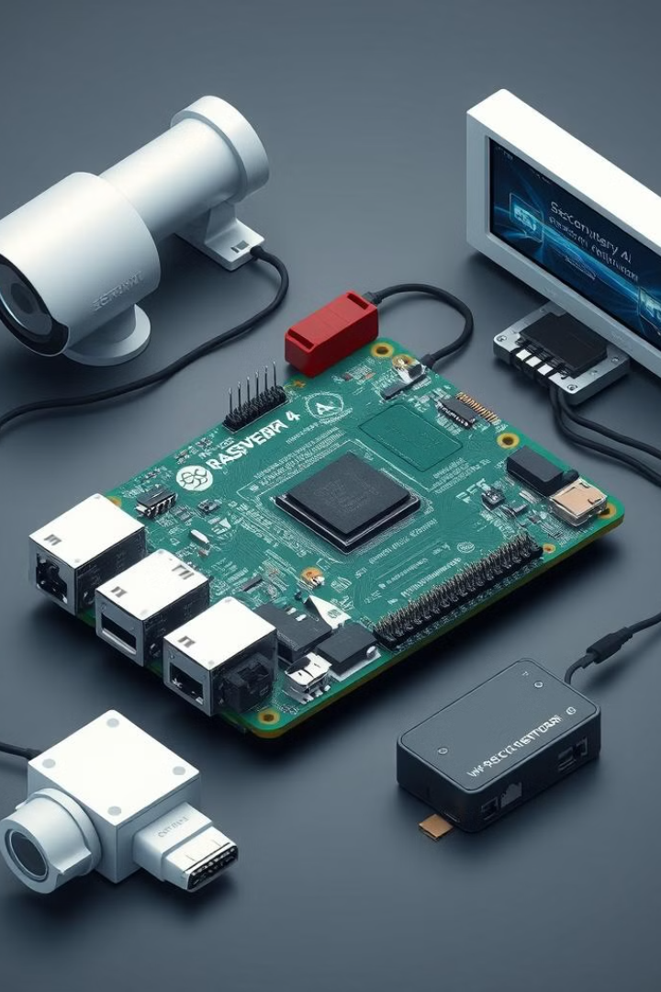



Proposed Solution: An Intelligent System
Central Unit
Raspberry Pi 4 serves as the core processor.
AI Detection
Machine learning powers intelligent detection capabilities.
Multi-Modal Sensing
Utilizes a combination of sensors for enhanced accuracy.
Key features include computer vision, real-time alerts, and customizable parameters.

Slide 6
Methodology: Components and Workflow
Hardware Components
Software Stack
Raspberry Pi 4 (4GB/8GB RAM)
Python-based ML
High-resolution camera
OpenCV for image processing
Infrared sensors
TensorFlow for neural networks
Network connectivity
The workflow involves continuous video analysis and machine learning threat classification.

Slide 7



System Architecture Diagram
Processing Layer
2
Physical Layer
1
3
Communication Layer
The system is organized into three layers: physical, processing, and communication. The processing layer does Image Preprocessing and Machine Learning.

Slide 8
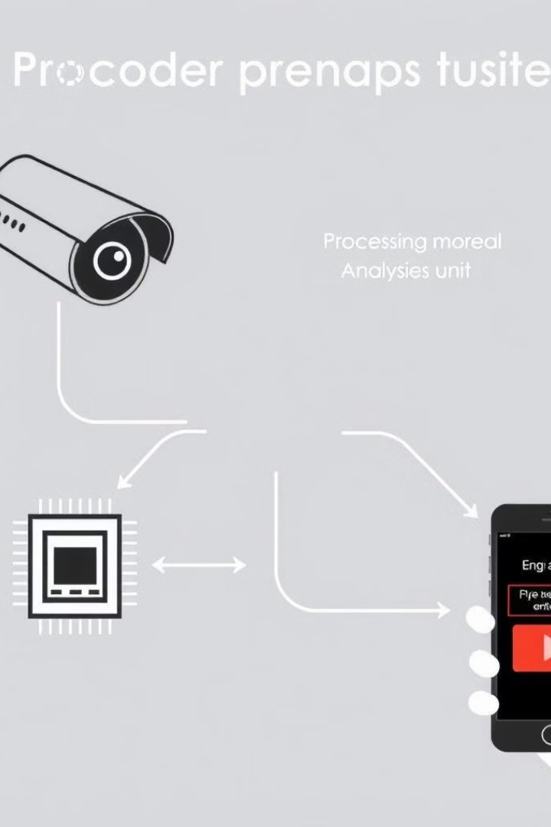
Data Flow Diagram: Processing the Data
Input Sources
Camera streams and sensor inputs.
Processing Steps
Frame capture, preprocessing, and feature extraction.
Classification
Machine learning to categorise potential threats.
Data flows from input sources through processing steps to output channels.

Slide 9
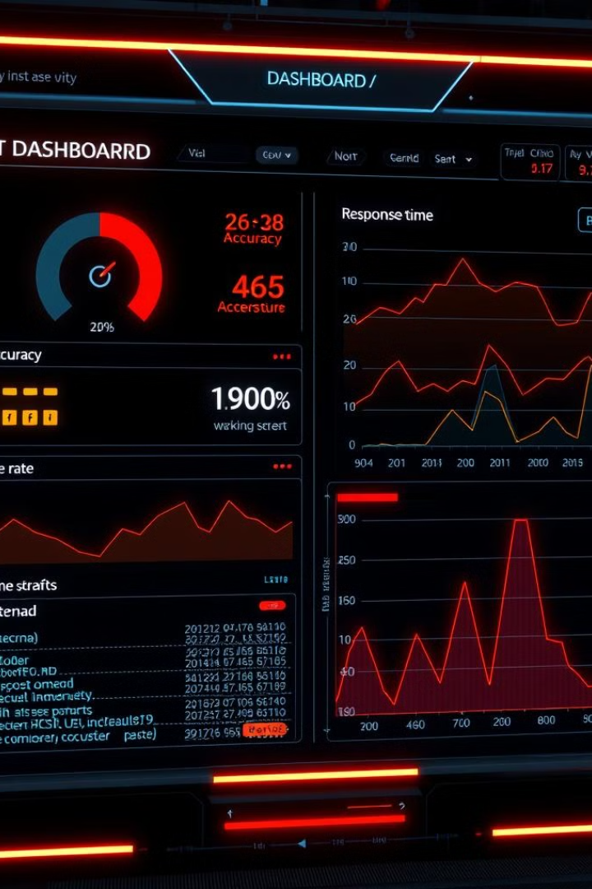
System Performance Metrics
95.7%
<3%
Detection Accuracy
False Positive Rate
<0.5
Response Time (seconds)
The system achieves high accuracy and low false positives with a fast response time. Implementation cost remains under $250.

Slide 10




Conclusion and Future Enhancements
Home Security
Industrial Monitoring
Smart City
We've demonstrated an intelligent, low-cost security solution. Future enhancements include enhanced ML models and multi-camera synchronization.

